Slide 1


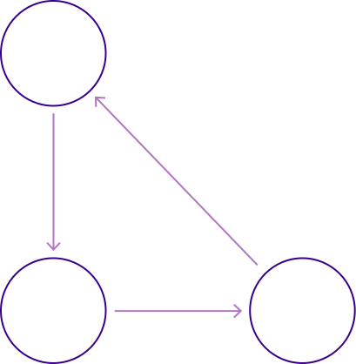
Inky Scribble: A Web-Based Drawing App
Inky Scribble Project Report
[Presented by]
Mohamed Safwat Hassan - 192100140
Abdallah Abdelmonem Abdelaziz - 192100154
Abdelrahman Omar Ali - 191900004
Hamed Mohamed Ragab - 191900056
Moomen Diaa Mohamed - 191800129
Ahmed Galal Abdelhay - 192200374

Slide 2
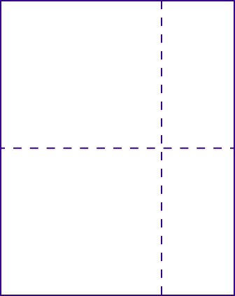

About Inky Scribble
A web-based drawing application for everyone
Inky Scribble offers a user-friendly platform to unleash your creativity through drawing, sketching.

Slide 3

STEP 2
STEP 1
Designing intuitive user interfaces for seamless interaction
Identifying user needs and outlining core features
STEP 3
STEP 4
Developing backend architecture to ensure smooth performance
Testing and optimizing for improvements

Slide 4



Inky Scribble offers an intuitive experience for users.
With features like customizable colors, users can create and share their artwork seamlessly.

Slide 5
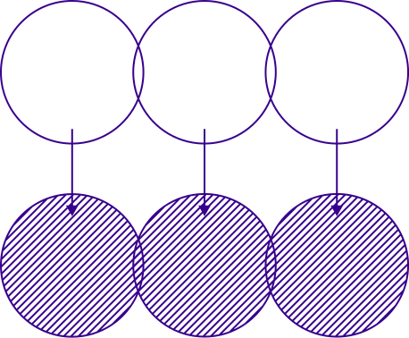
Less is More
⚡
EXPLORE OUR FEATURES AND START DRAWING TODAY!

